Slide 1

PUZZLEMENIA
Albert Pasco
Piolo Torotoro
Edwil Joshua Sadsad
BSCS II - A

Slide 2
A Fun, Enjoyable and Educational Puzzle Game for everyone that will help you to improve your skills in logical thinking. This game is composed of Words puzzles ,Number puzzles, Pictures puzzles and
extra logical problems that will surely make you think deeply.

Slide 3
Objectives:
1. Help you to raise you intelligence Quotient.
2. Improve your memory capacity, Spatial Imagery, logics, and problem solving skills.
3. Advanced feel for mathematical puzzle, and language skills.

Slide 4
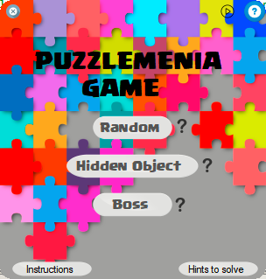

Slide 5
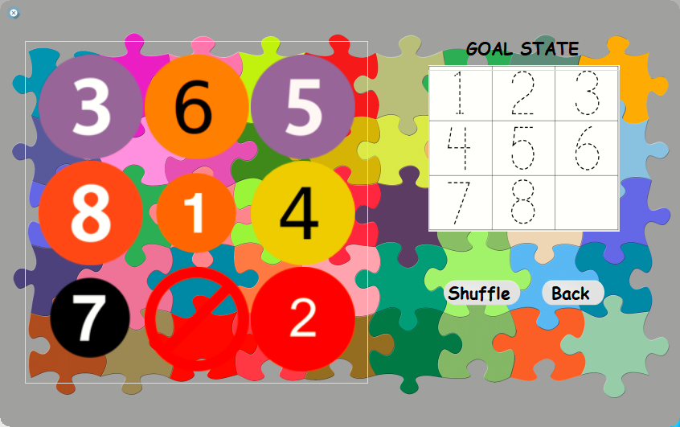
RANDOM

Slide 6
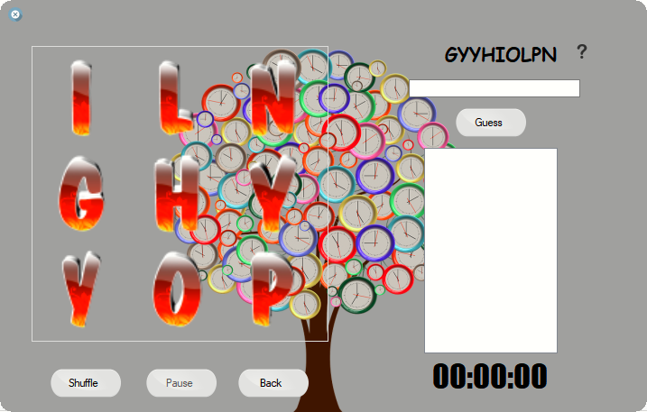

Slide 7
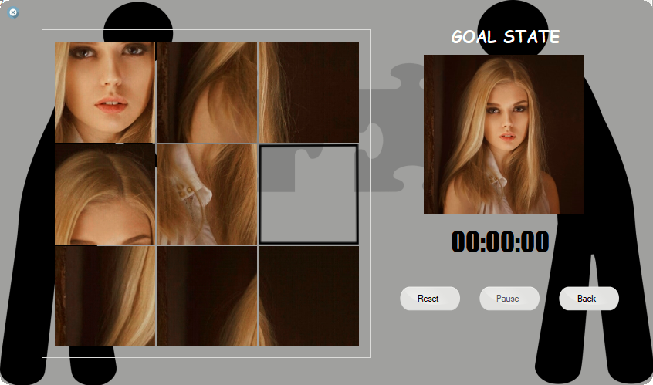

Slide 8
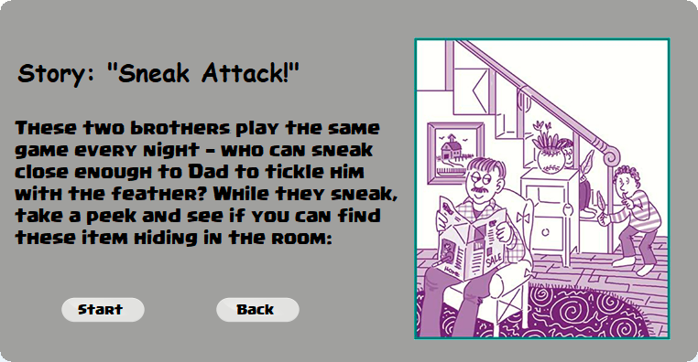
HIDDEN OBJECT

Slide 9
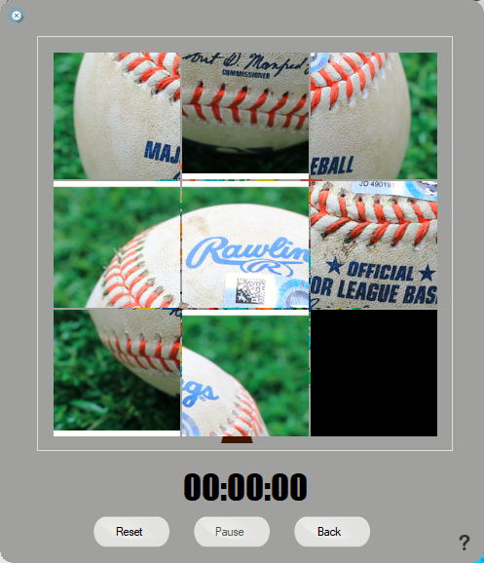

Slide 10
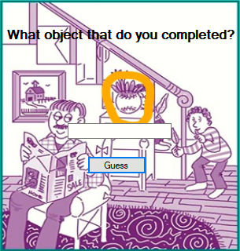

Slide 11
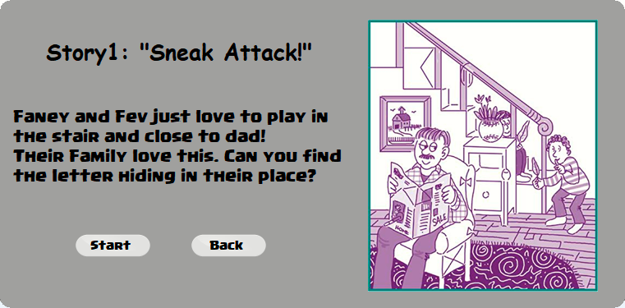

Slide 12
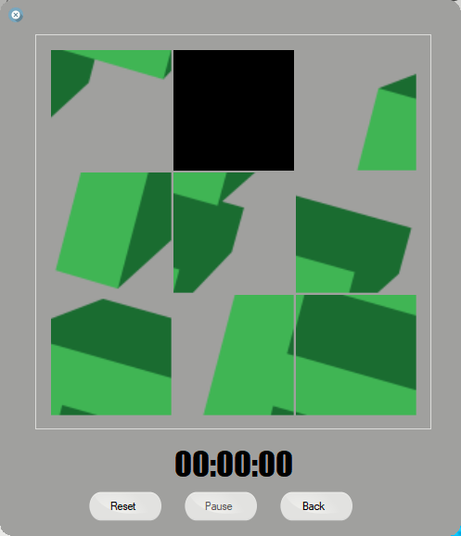

Slide 13
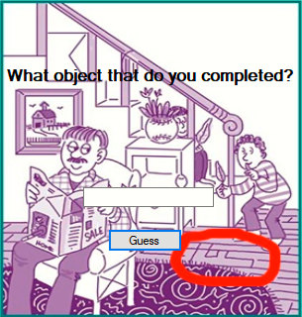

Slide 14
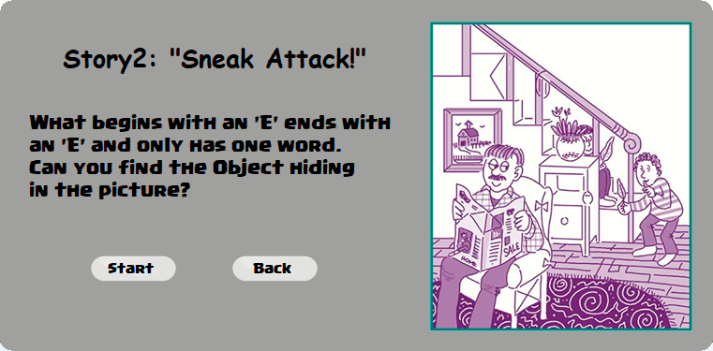

Slide 15
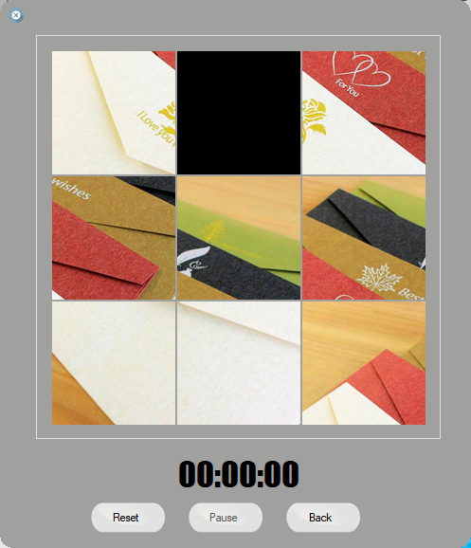

Slide 16
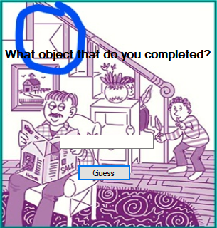

Slide 17
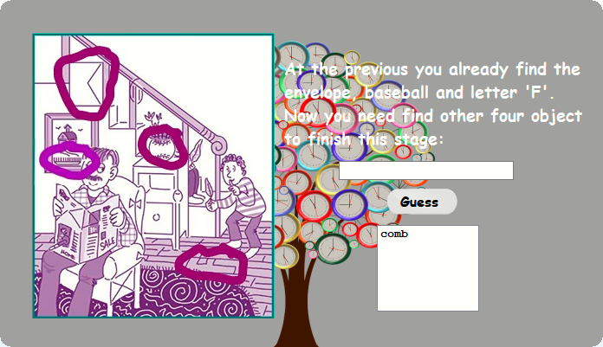

Slide 18
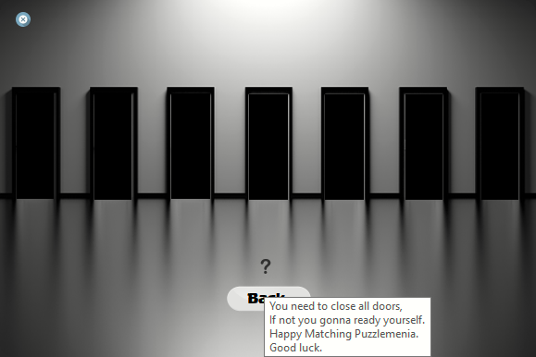
BOSS

Slide 19
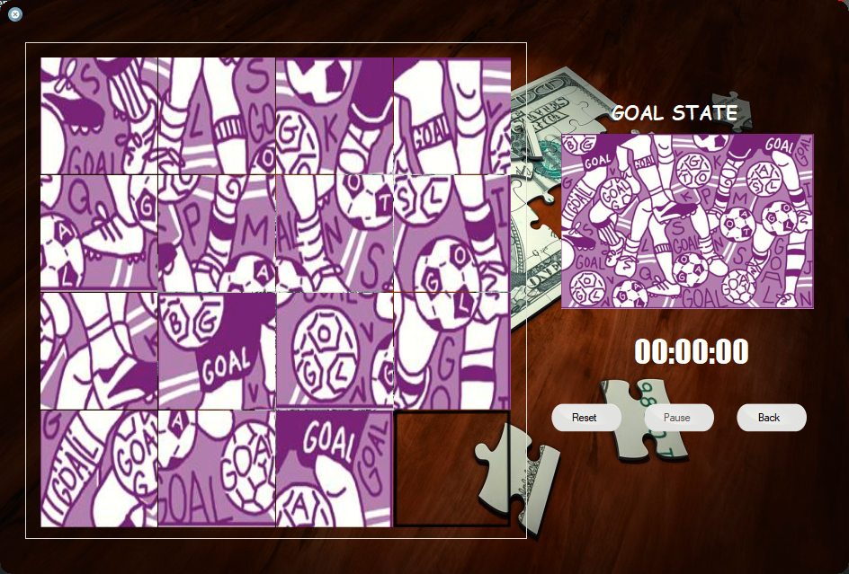

Slide 20
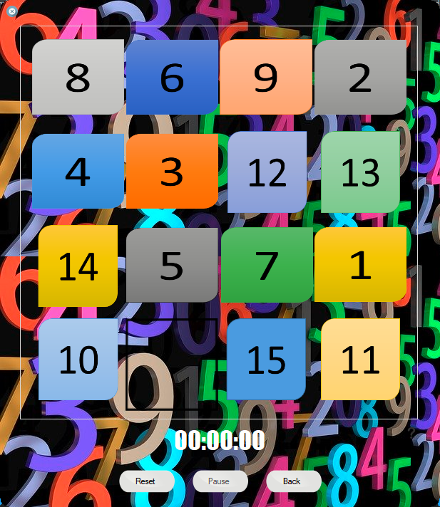

Slide 21
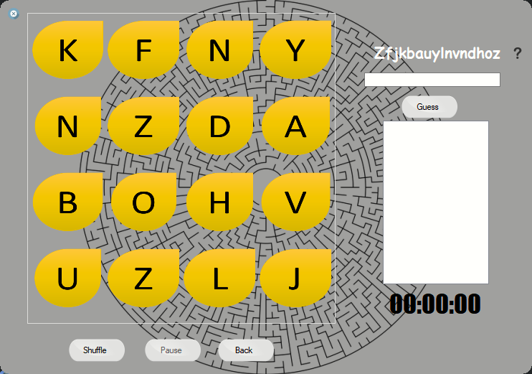

Slide 22
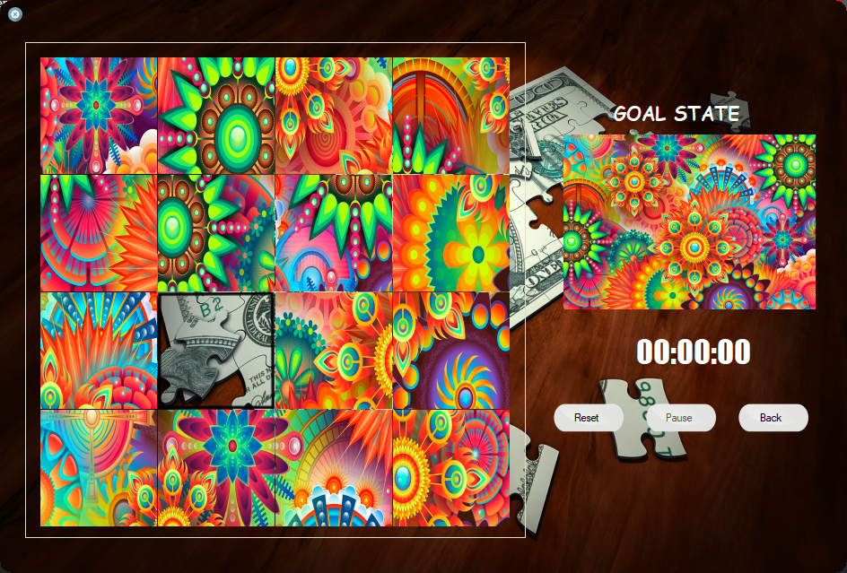

Slide 23
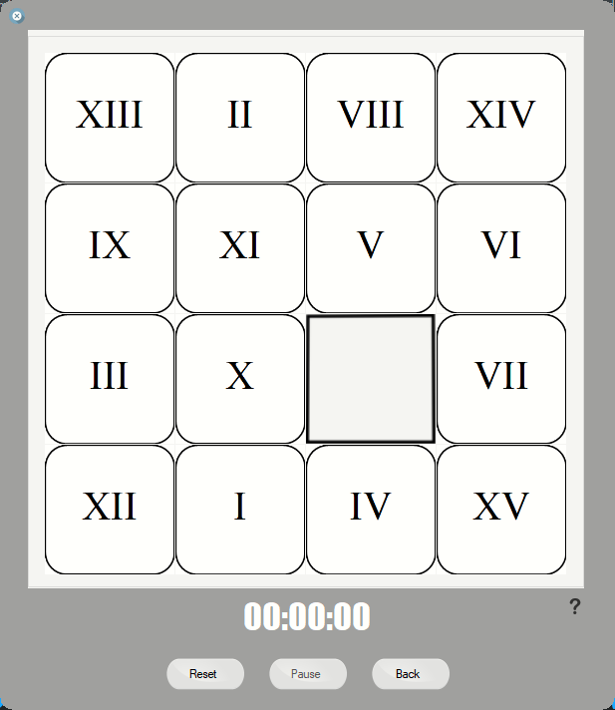

Slide 24
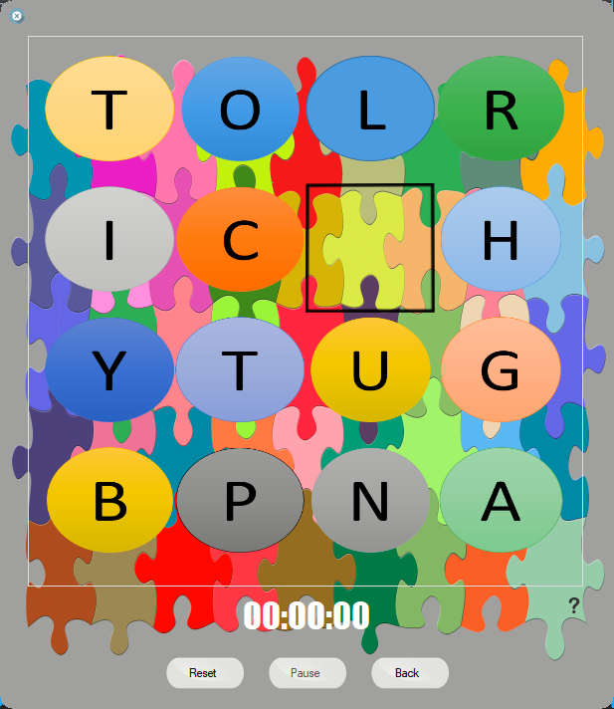

Slide 25
THANK
YOU!
BSCS II - A

